Slide 1
Pricing and Revenue Optimization
Prof. Ozgur Ozluk

Slide 2
Perfectly Competitive Markets
Many firms, each with a small market share
Homogeneous product
Perfect information
No barriers to entry
No pricing decisions necessary

Slide 3
E-Commerce
Velocity of Pricing Decisions
Immediate Wealth of Information
Unique Laboratory
More Aware Consumers

Slide 4
Pricing Optimization
Analytical models to:
– Mine Historical data (sales, prices, competition)
– Estimate elasticities
– Based on elasticities and costs, determine prices that improve overall profitability

Slide 5
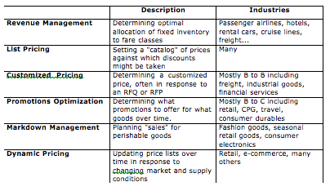
Pricing Strategies

Slide 6
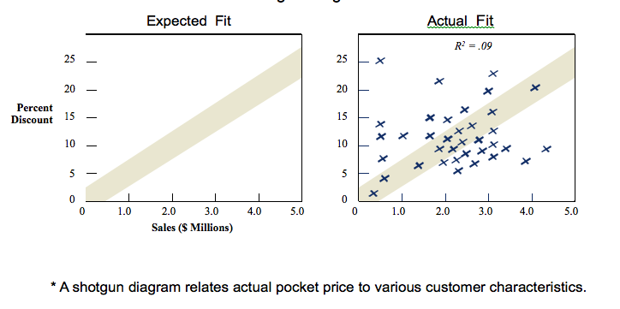
Correlation?

Slide 7
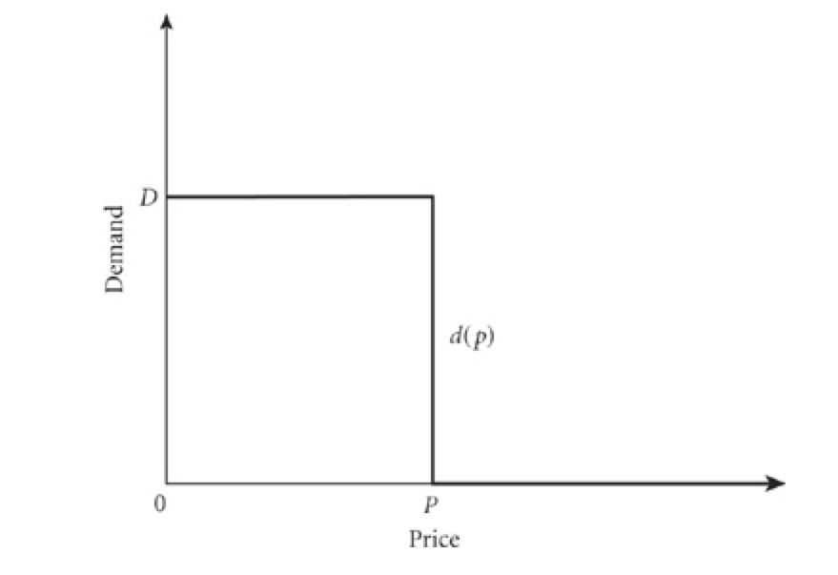
Price-Response Function Perfectly Competitive Markets

Slide 8
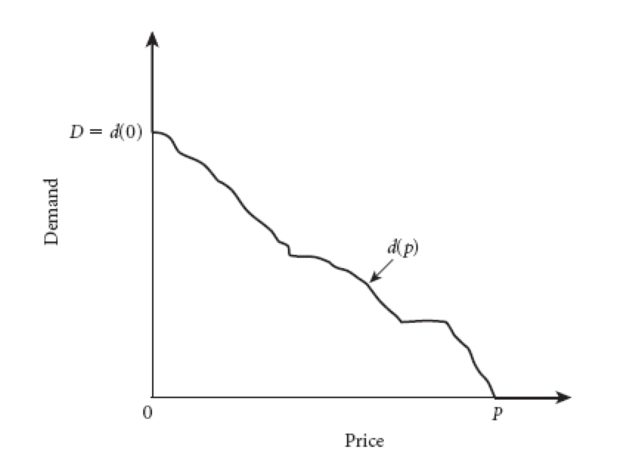
Typical Price-Response Curve

Slide 9
Properties
Nonnegative
Continuous
Differentiable
Downward sloping - unless
Giffen goods
Quality indicator
Conspicuous consumption

Slide 10
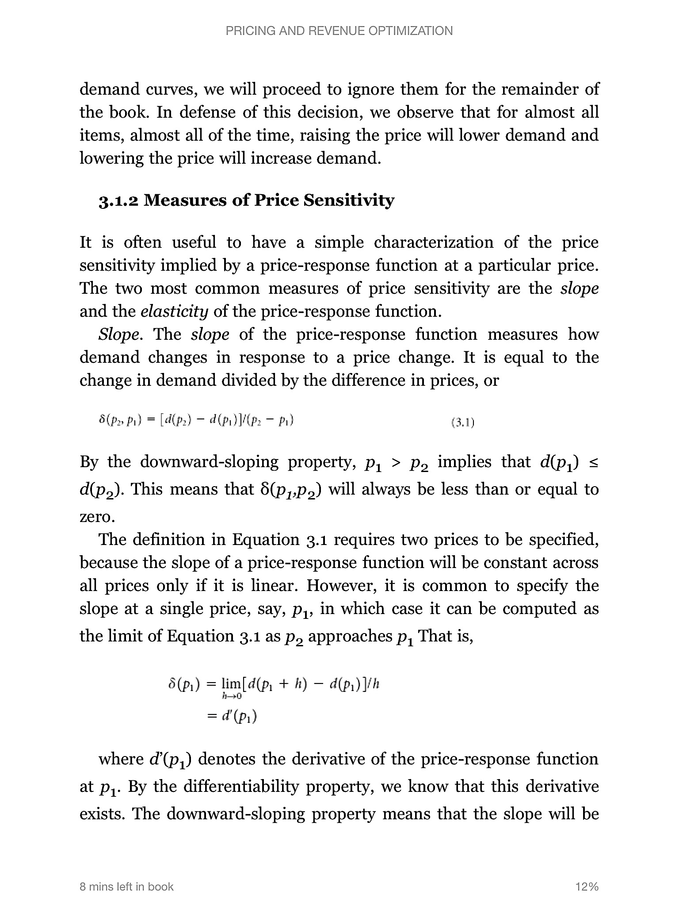
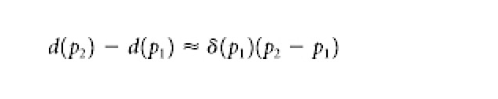
Measures of Price Sensitivity
SLOPE

Slide 11
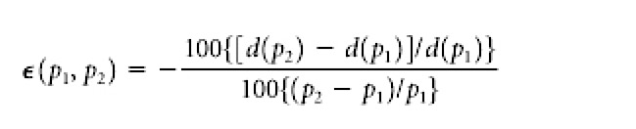
Measures of Price Sensitivity
PRICE ELASTICITY
Arc Elasticity

Slide 12
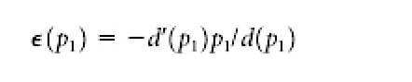
Measures of Price Sensitivity
PRICE ELASTICITY
Arc Elasticity
Point Elasticity

Slide 13
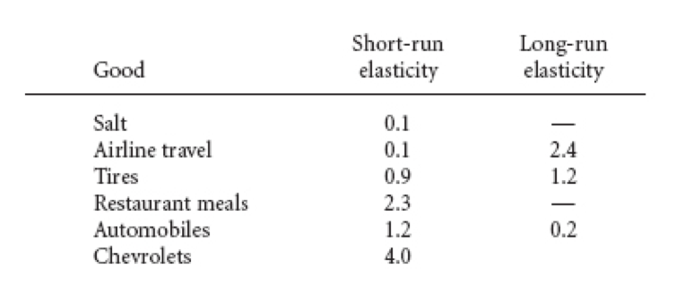
Short Run vs. Long Run Elasticity

Slide 14
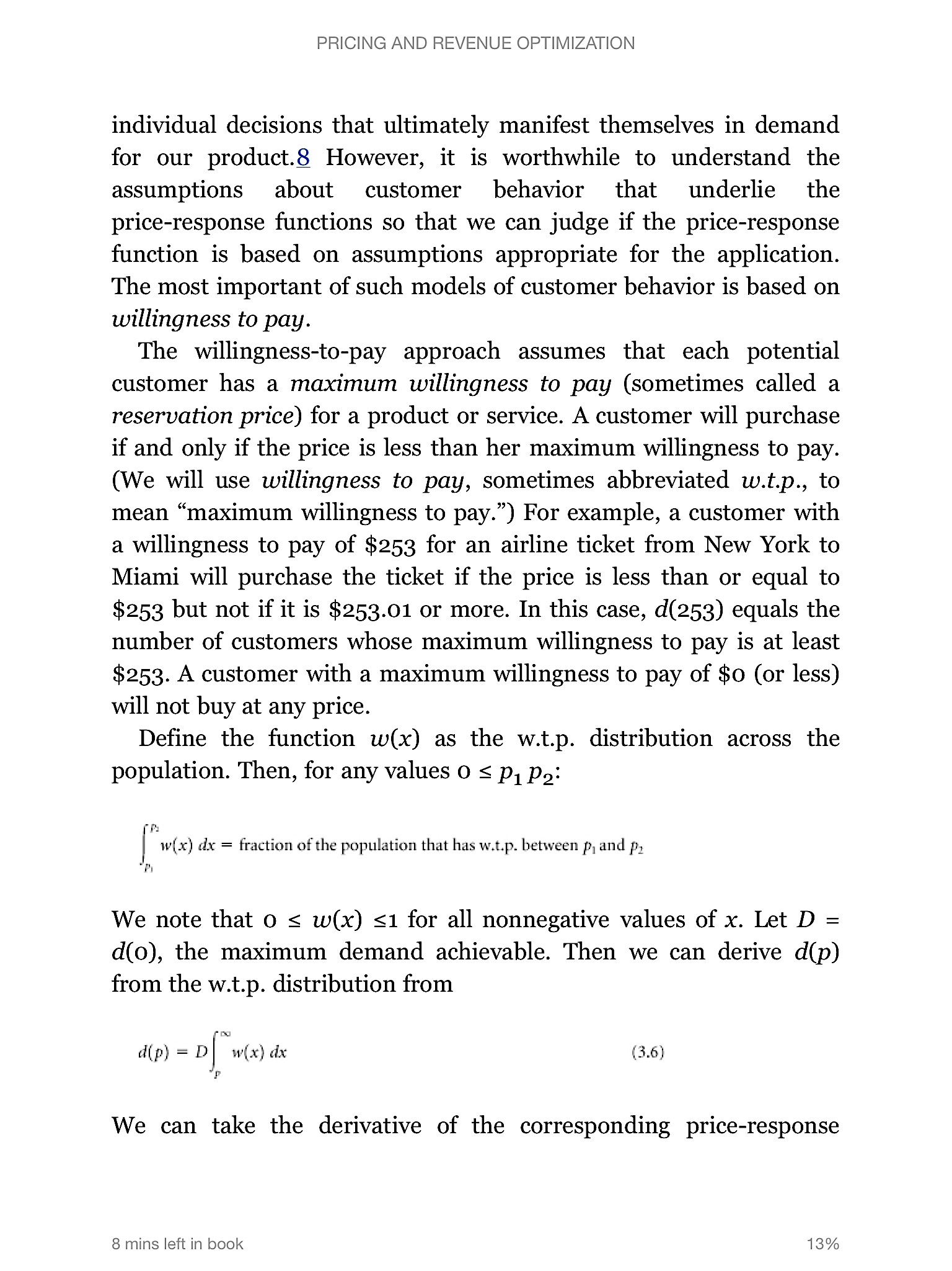
Willingness to Pay

Slide 15
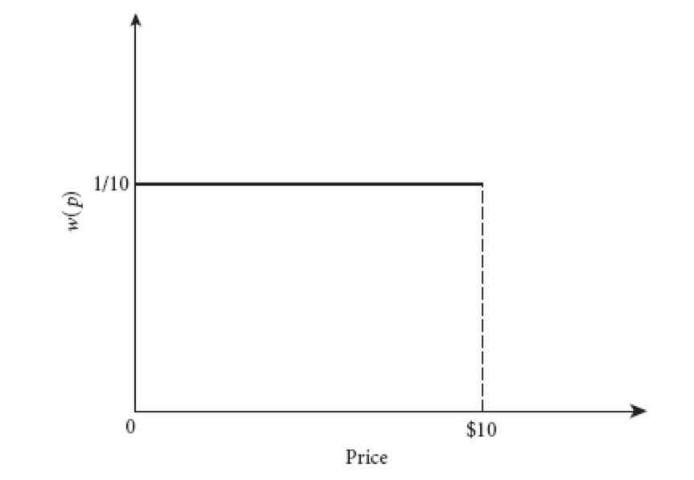
Uniform Willingness to Pay

Slide 16
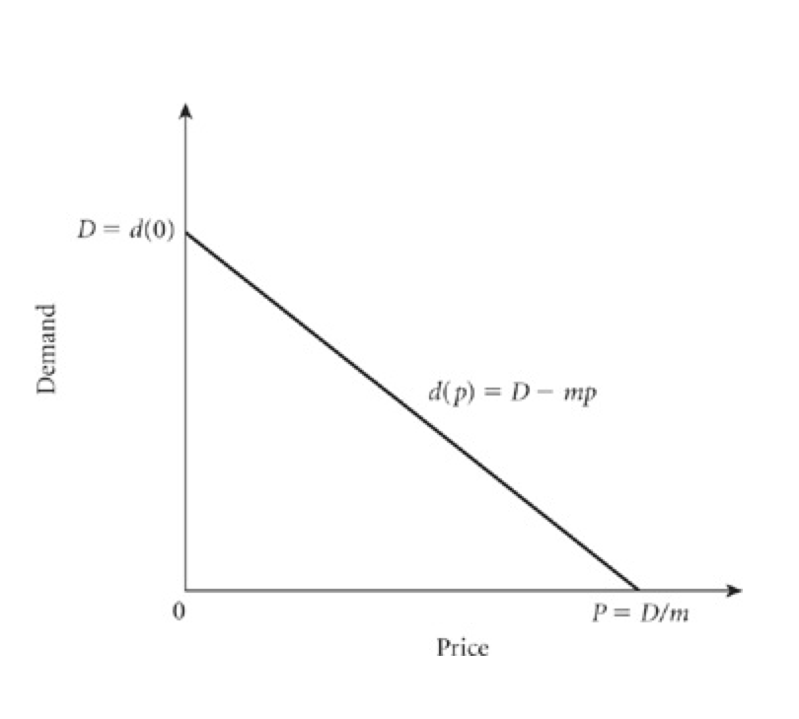
Linear Price-Response Function
Notes:
Not realistic 1 TL ıncrease in price gives the same change

Slide 17
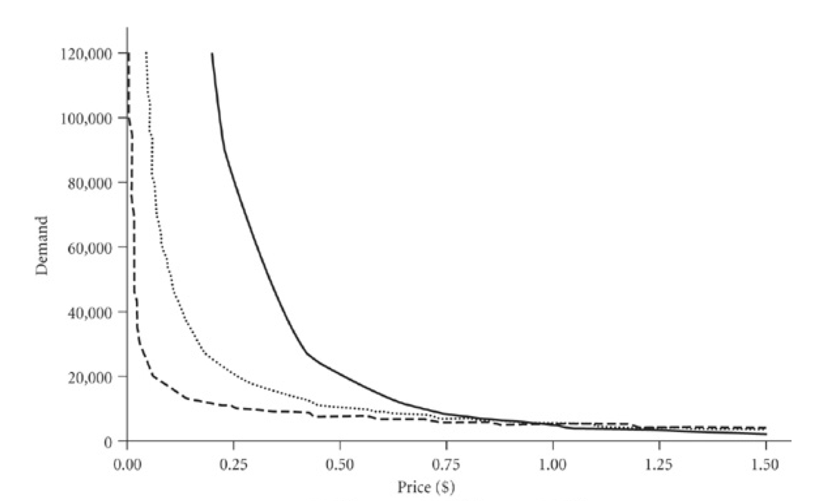
Constant-Elasticity Price-Response
Notes:
Constant elasticity formulae

Slide 18
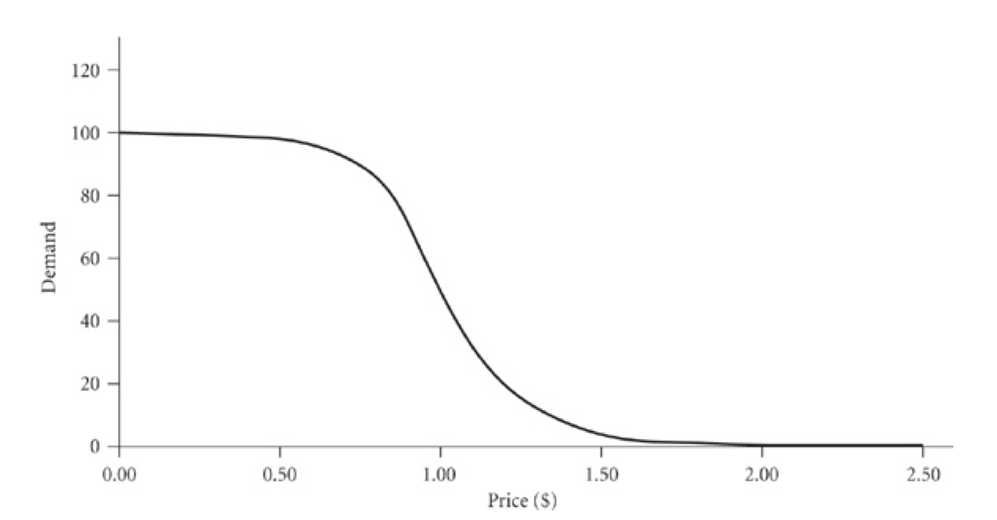
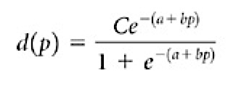
Logit Price-Response Function
Notes:
Why the S shape?

Slide 19
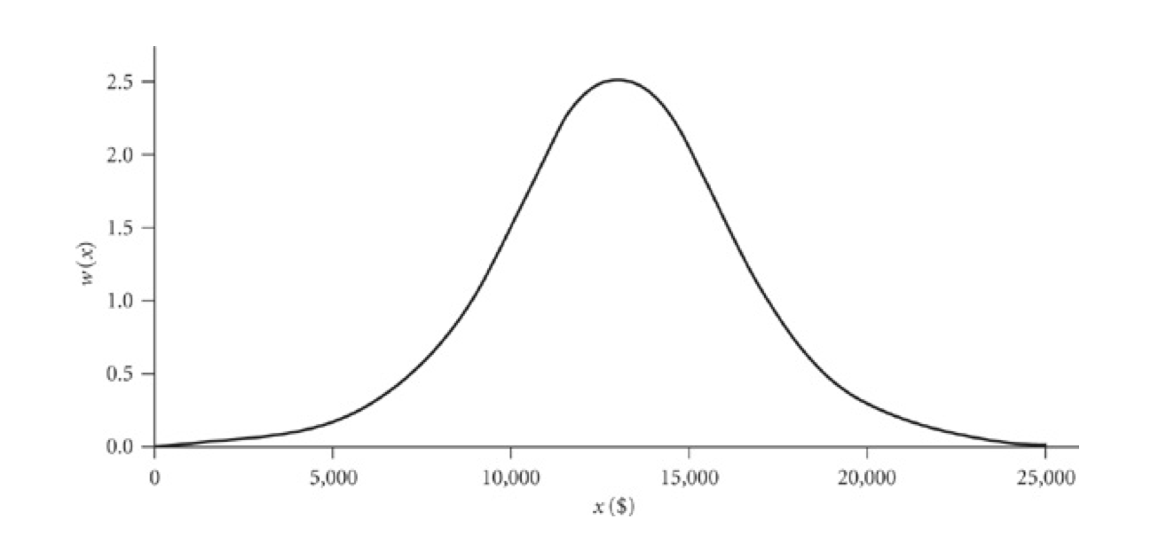
WTP: Logit Price-Response

Slide 20
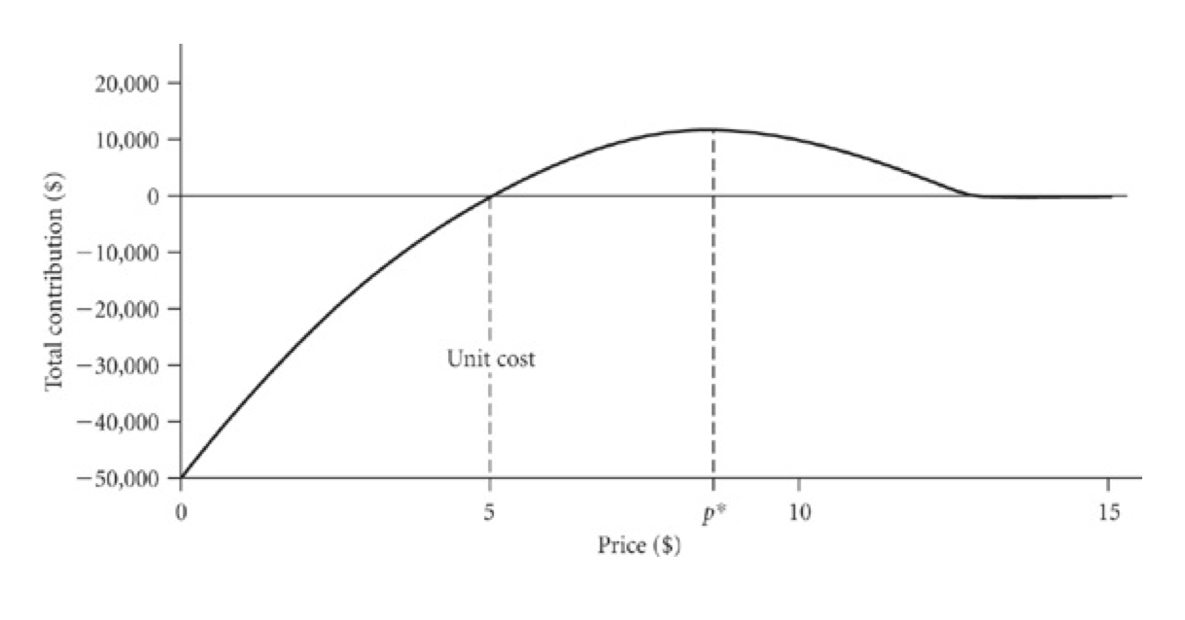
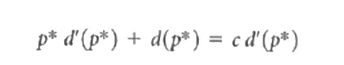
Basic Price Optimization
max m(p) = ( p – c ) d(p)

